Slide 1


How to really use Copilot Pro Part 5

Slide 2

Now, let’s think about what this Copilot should avoid doing. Are there any specific actions or behaviors you don’t want it to exhibit?
-Microsoft Copilot

Slide 3

Existing GPTs

Slide 4


Slide 5


Slide 6
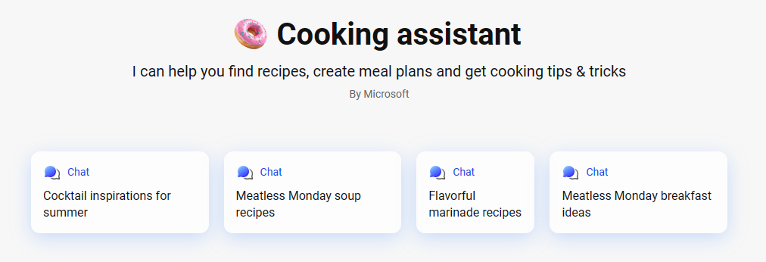

Slide 7
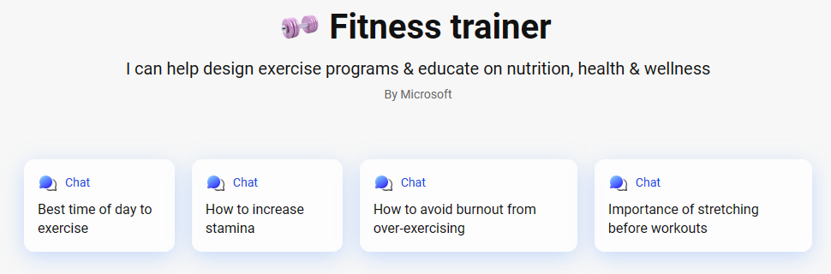

Slide 8

Building your own gpts

Slide 9
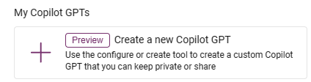
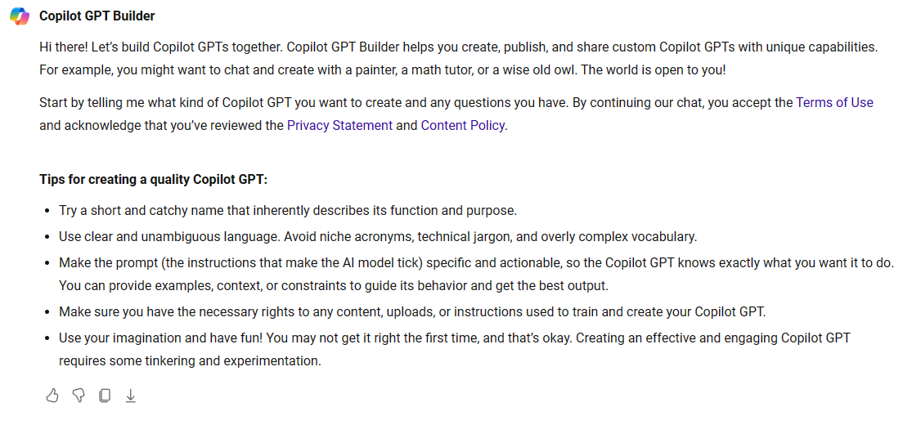

Slide 10


